Slide 1

B.M.S COLLEGE OF ENGINEERING
Bull Temple Road, Basavanagudi, Bangalore - 560 019, Karnataka, India
SCALABLE VITALS MONITORING SYSTEM
Rahul Kamath - 1BM17EC080
Rakshith P - 1BM17EC086
Rohan Sathish - 1BM17EC143
0
Under the guidance of Mrs. Bhavana , Assistant Professor, Dept of Electronics and Communication
ICTIEE 2022

Slide 2

INTRODUCTION
Vital health parameter monitoring systems in the modern day require an IoT based approach for effective identification of ailments.
Providing both scalability and ease-of-access in populous areas is essential.

Slide 3
SCOPE OF THE PROJECT
VITALS TRACKING
COMPATIBILITY
SCALABILITY
Suitable sensors to track vitals and keep a check on human movement will help curb potential spreading events
This system should be compatible with existing LANs and allow future scope for Data Analysis.
Should be implementable in organizations of all sizes
Notes:
Compatibility with Data science oriented researches

Slide 4

PROPOSED SOLUTION
A nodular system with each node consisting of a microcomputer-sensor combination with a centralized local server to host the data and the front-end of the user interface.
This enables scalability of the system.
The centralized server will make adding extra nodes a simple task.
The front-end can be accessed by the users through their own mobile phones, thus making each node a minimal-contact terminal.

Slide 5
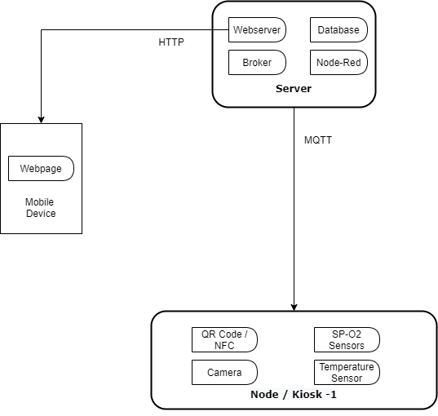
PROPOSED SOLUTION FLOW
System Block Diagram

Slide 6

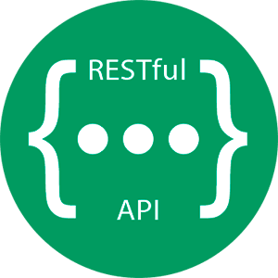


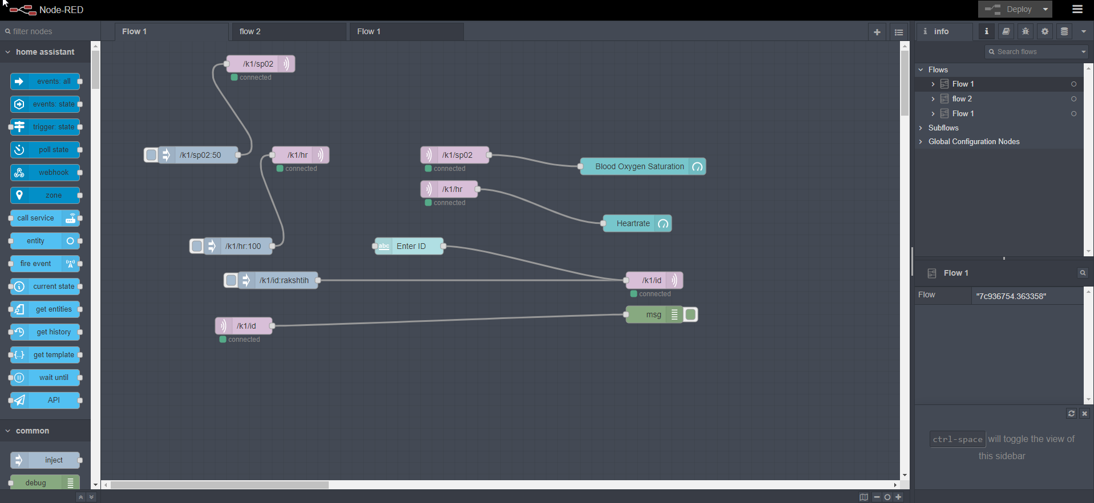

TECHNOLOGY STACK

Slide 7
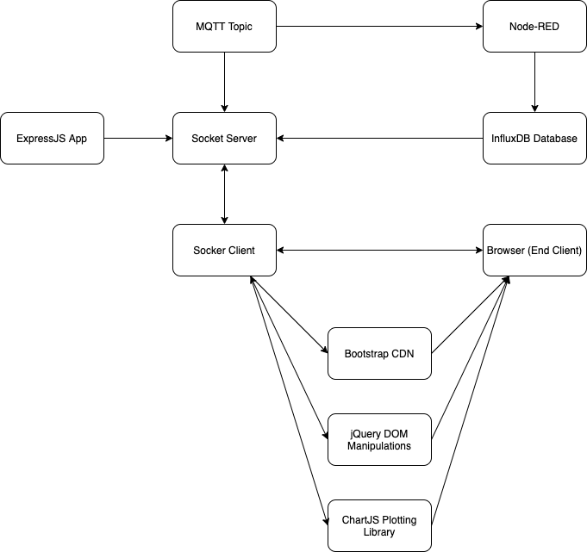
SOFTWARE IMPLEMENTATION

Slide 8
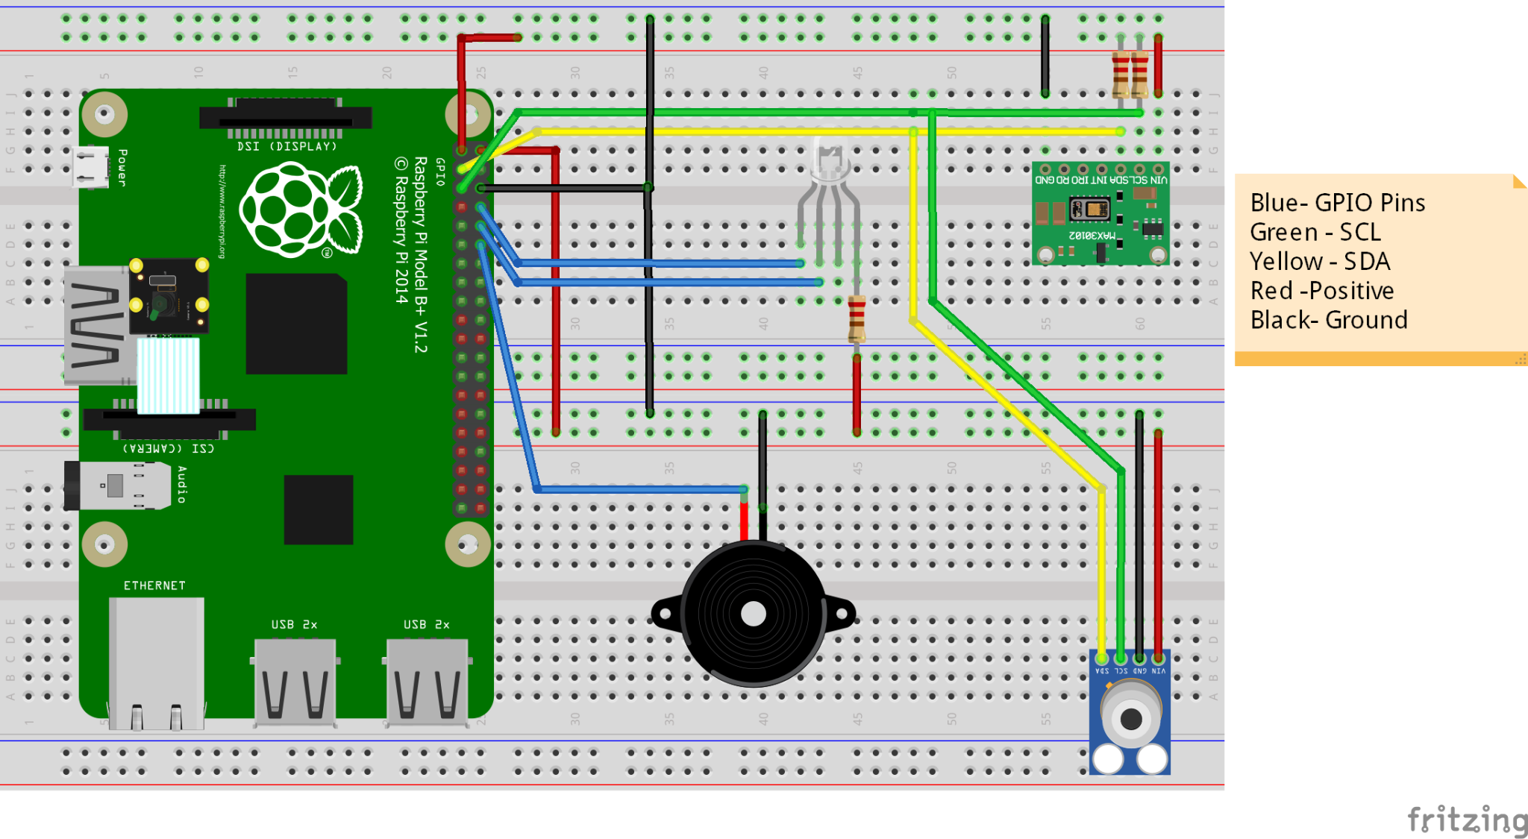
CIRCUIT DIAGRAM
Notes:
8-14 Rahul

Slide 9
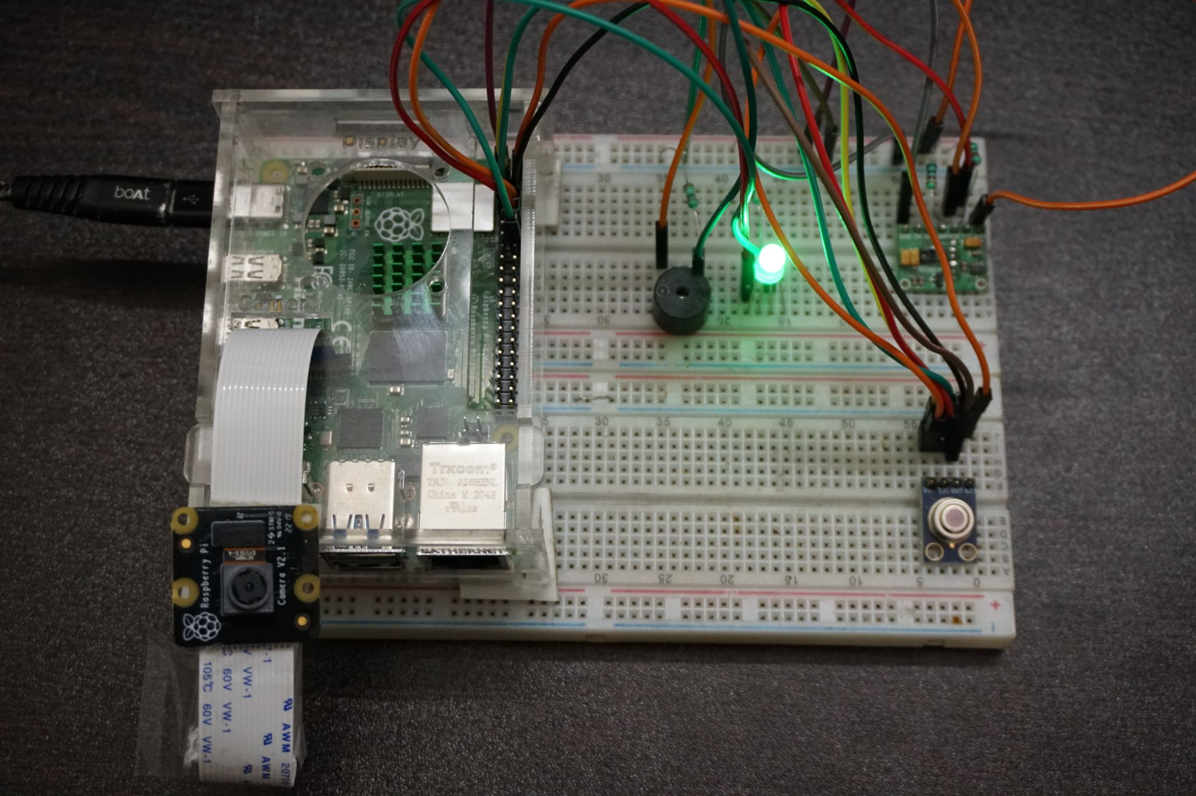
HOW TO USE THE KIOSK
When the system is turned ON, the LED turns GREEN to show that the system is ready to operate.
The Raspberry Camera is used to scan the user’s QR code and obtain his/her user ID.
Upon logging the user’s ID details, the buzzer beeps and the system moves into the next stage.

Slide 10
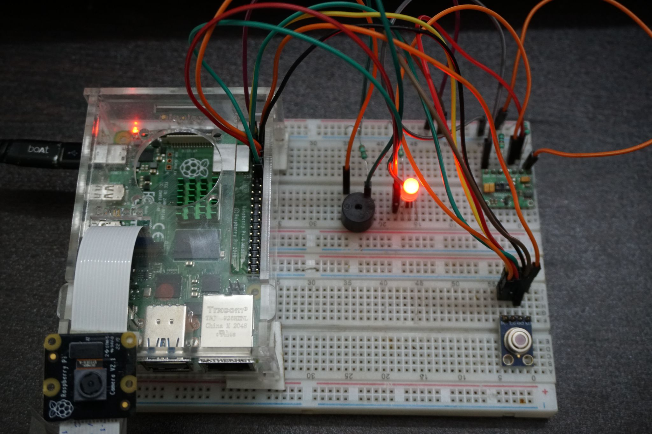
HOW TO USE THE KIOSK
Next, the LED turns RED to show that the system is ready to receive user’s health information via the sensor.
When the user places their finger on the MAX30100 sensor, the LED starts blinking to show that scanning is underway.
After the scan is complete, the vitals’ details are displayed on the webpage dashboard and the LED turns GREEN

Slide 11
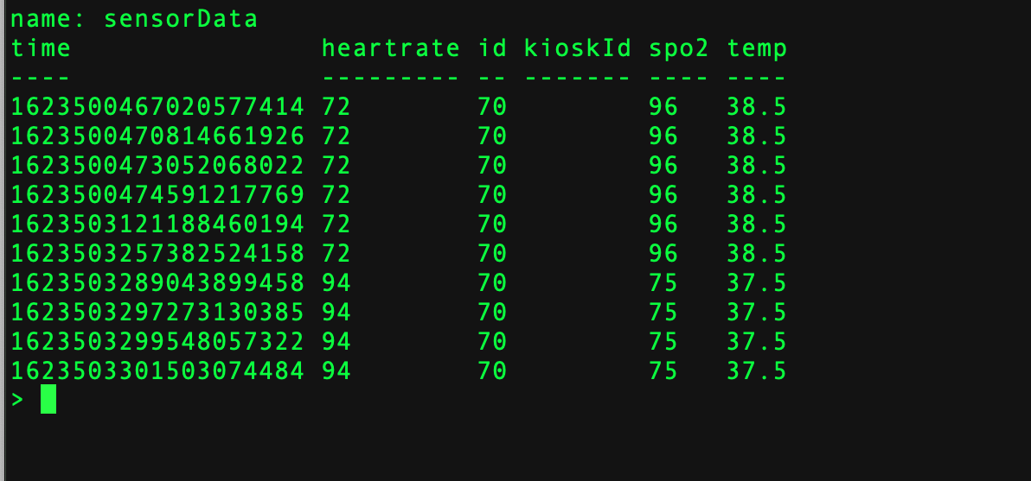
RESULTS
The readings of the sensor were stored in the InfluxDB database and also displayed on the dashboard. This logged data can be retrieved anytime by querying into the database.
The scalable nature of this design makes adding more sensor nodes easy and efficient.

Slide 12
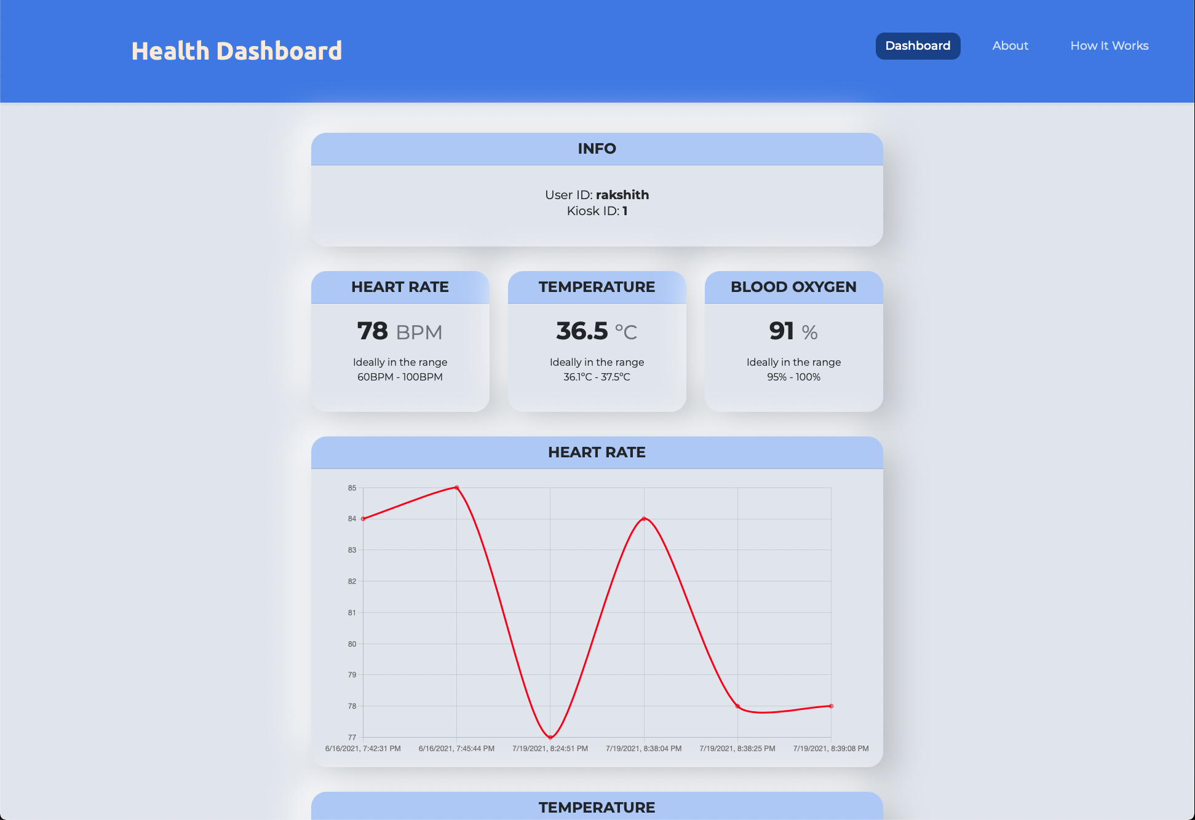
RESULTS
Notes:
29-30 Rohan

Slide 13
THANK YOU

